Slide 1


Comparison of Human Chest Diameter and Height
Anurag Dinesh Karmarkar

Slide 2
Introduction
The problem focusses on the chest diameter and the height of a certain population of people.
The dataset used consists of body girth measurements and skeletal diameter measurements, as well as age, weight, height, and gender.
The measurements are given for 507 physically active individuals - 247 men and 260 women.
This investigation will seek to understand if there is any statistically significant relationship between a person’s chest diameter (che.di) and height (hgt).

Slide 3
Problem Statement
The investigation of this data seeks to understand if there is any statistically significant relationship between a person’s chest diameter and height.
This investigation will make use of important statistical concepts like scatter plots, histograms etc. to determine if there is a significant difference between a person’s chest diameter and height.
We will further use the regression analysis and null hypothesis testing to calculate the dependent variable (y), predictor (x), intercept (α), the slope (β) and the residuals (ε).

Slide 4
Data Collection and Preparation
The dataset was found to be quite consistent and without errors.
The data was imported in RStudio.
The columns titled chest diameter (che.di) and height (hgt) were selected in a seperate data frame for ease in the analysis using select() function.
Data analysis was performed using various plots and test functions built in RStudio.

Slide 5
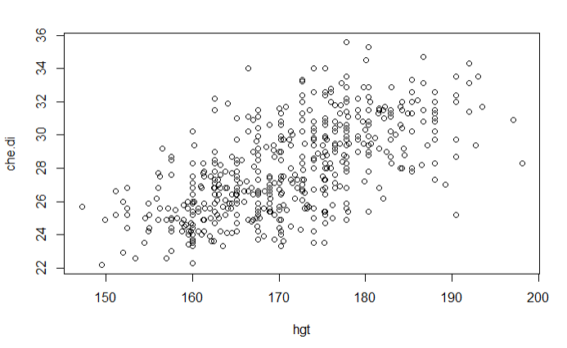
Descriptive Visualization
The figure shows a scatter plot of the chest diameter versus height.
Code snippet: plot(che.di ~ hgt, data = bdims_filtered)
It is very difficult to infer from the graph about its linearity.
Hence, we need to plot a histogram.

Slide 6

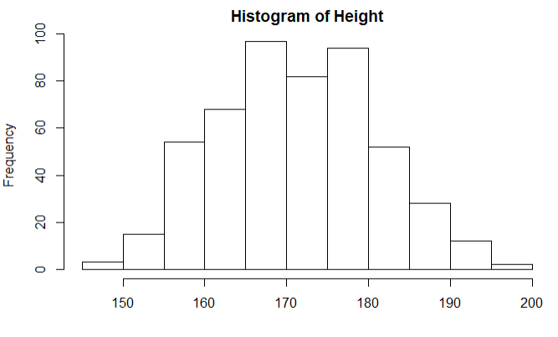
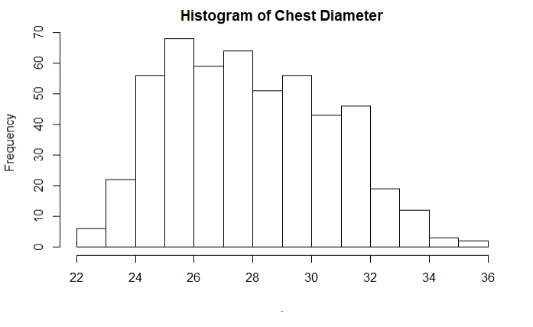
Descriptive Visualization
The code snippet is as follows.
bdims_filtered$che.di %>% hist(main="Histogram of Chest Diameter“)
bdims_filtered$hgt %>% hist(main="Histogram of Height")
We can observe that the data is slightly right skewed in both the cases.
This skewness can be corrected by plotting the log distributions for both the parameters.
This can be seen in the following slide.

Slide 7
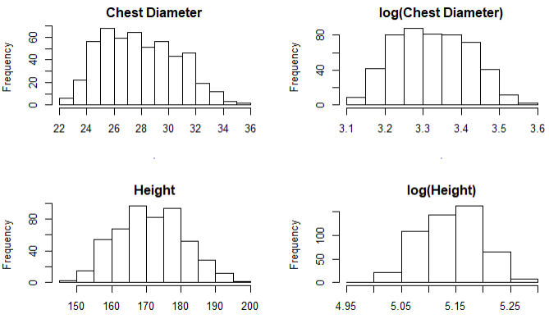
Descriptive Visualization
We can observe that the chest diameter and height, when converted to logarithmic distribution, are no longer skewed.
We will thus use the logarithmic distributions for the two parameters for our analysis.
par(mfrow=c(2,2)) bdims_filtered$che.di %>% hist(main = "Chest Diameter") log(bdims_filtered$che.di) %>% hist(main = "log(Chest Diameter)") bdims_filtered$hgt %>% hist(main = "Height") log(bdims_filtered$hgt)%>% hist(main = "log(Height)")

Slide 8
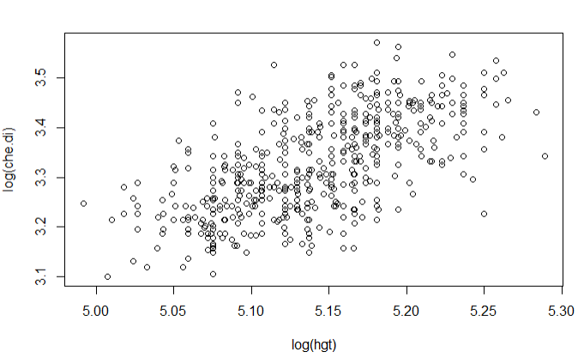
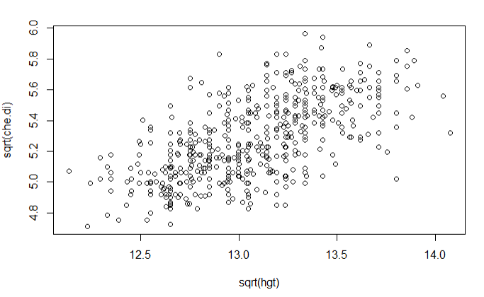
Comparison Between Distributions
Log Distribution
Square root Distribution

Slide 9
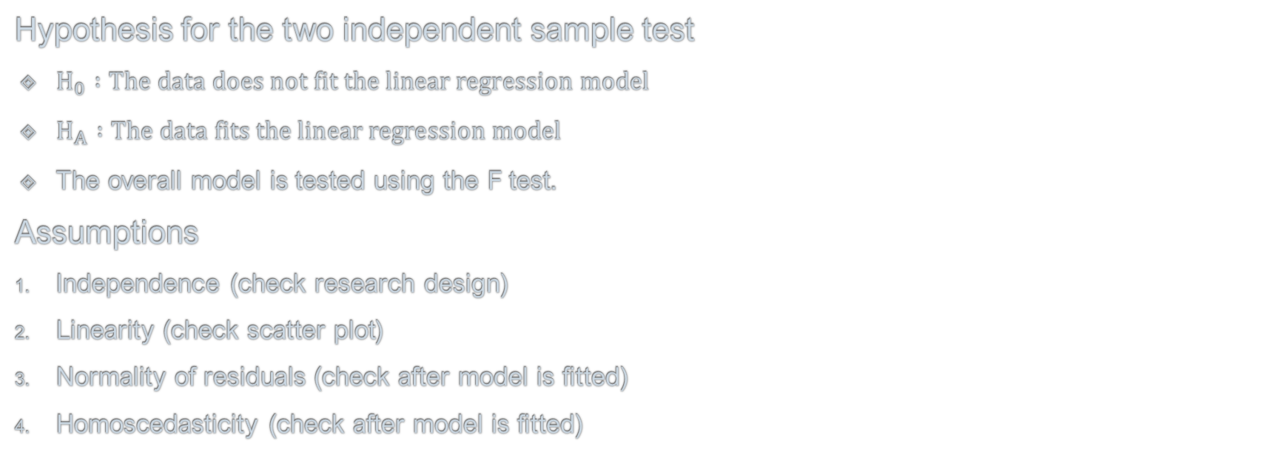
Hypothesis Testing
Hypothesis for the two independent sample test
$H_{0} :The data does not fit the linear regression model$
$H_{A} :The data fits the linear regression model$
The overall model is tested using the F test.
Assumptions
Independence (check research design)
Linearity (check scatter plot)
Normality of residuals (check after model is ﬁtted)
Homoscedasticity (check after model is ﬁtted)

Slide 10
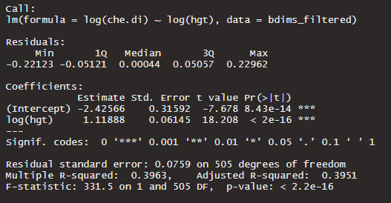
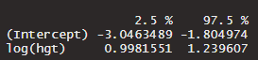
Linear Regression Testing
We have used the lm() function to test the model. The code snippet and the result is as follows.
lmtest <- lm(log(che.di) ~ log(hgt), data = bdims_filtered)
lmtest %>% summary()
The coefficient confidence intervals are calculated as follows.
lmtest %>% confint()

Slide 11
Linear Regression Testing
P value is very small as p < 0.001. The model is statistically significant
F Statistic is F(1,505) = 331.5
Model coefficients are as follows
α (intercept) = -2.42566 == -2.43, 95% CI (-3.0463489 -1.804974)
β (slope) = 1.11888 == 1.12, 95% CI (0.9981551 1.239607)

Slide 12

Hypothesis Testing for Coefficients
Hypothesis testing for coefficients is as follows
For $α$
$H_{0} :α=0$
$H_{A} :α≠$ 0
For $β$
$H_{0} :β=0$
$H_{A} :β≠0$

Slide 13
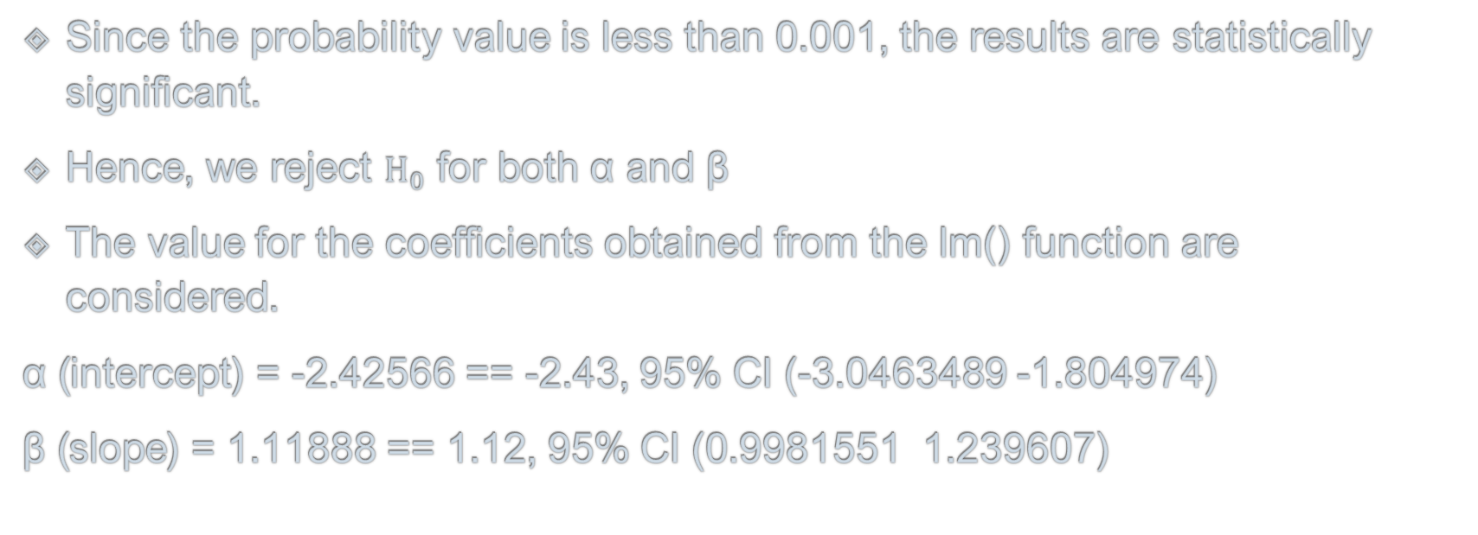
Hypothesis Testing for Coefficients
Since the probability value is less than 0.001, the results are statistically significant.
Hence, we reject $H_{0}$ for both α and β
The value for the coefficients obtained from the lm() function are considered.
α (intercept) = -2.42566 == -2.43, 95% CI (-3.0463489 -1.804974)
β (slope) = 1.11888 == 1.12, 95% CI (0.9981551 1.239607)

Slide 14
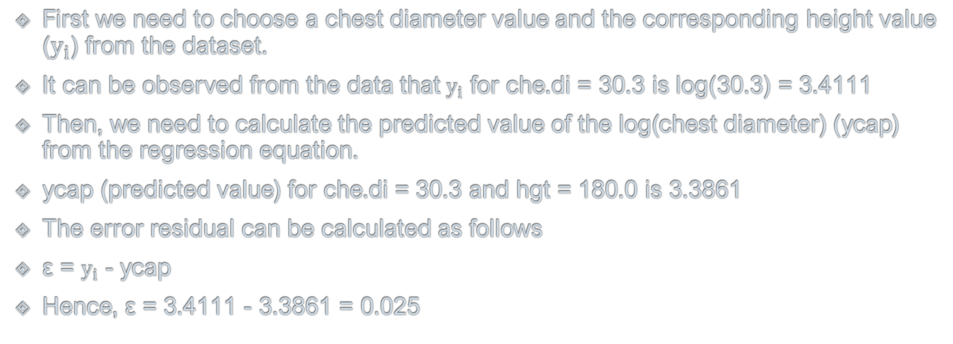
Error Residual
First we need to choose a chest diameter value and the corresponding height value ($y_{i}$) from the dataset.
It can be observed from the data that $y_{i}$ for che.di = 30.3 is log(30.3) = 3.4111
Then, we need to calculate the predicted value of the log(chest diameter) (ycap) from the regression equation.
ycap (predicted value) for che.di = 30.3 and hgt = 180.0 is 3.3861
The error residual can be calculated as follows
ε = $y_{i}$ - ycap
Hence, ε = 3.4111 - 3.3861 = 0.025

Slide 15
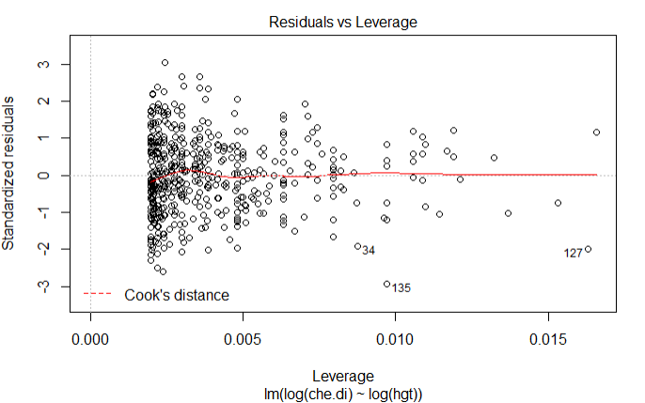
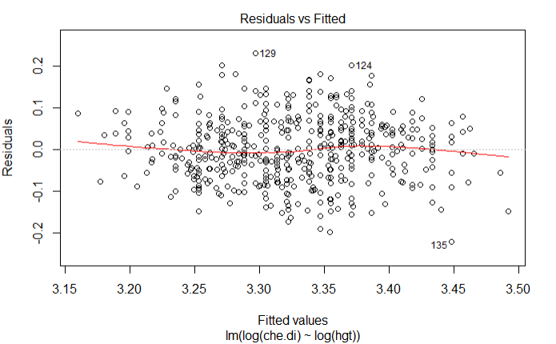
Testing Assumptions
In the plot, no values fall close to 0.5 band. In fact, the bands are not even visible.
Hence, there are no influential cases.
Code: lmtest %>% plot(which = 5)
Independence can be assumed by using the dataset itself.
As the line is almost straight in the Residuals versus Fitted graph, the model strongly tends towards linearity.
Code snippet: lmtest %>% plot(which = 1)

Slide 16
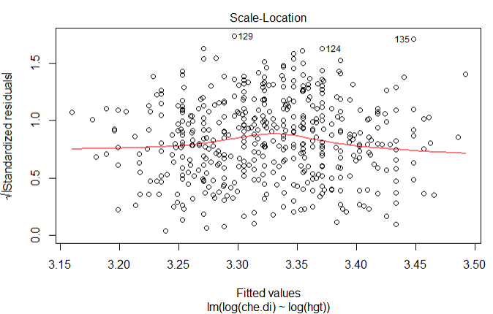
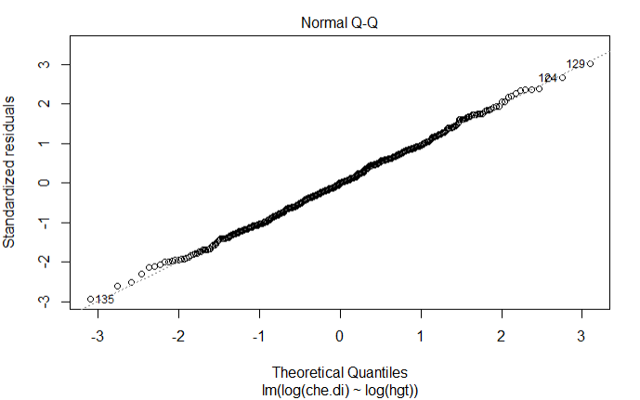
Testing Assumptions
Homoscedasticity can be assumed as the red line in the first graph is almost flat.
Code: lmtest %>% plot(which = 3)
The normality of residuals is proved by using the Q-Q Plot.
As most of the points lie on the doted line, the distribution can be assumed to be normal.
Code: lmtest %>% plot(which = 2)

Slide 17
Regression Coefficient
The regression coefficient is r = 0.6295466, 95% CI (0.5739283 0.6793837)
Code
r <- cor(log(bdims_filtered$che.di), log(bdims_filtered$hgt), use = "complete.obs")
The confidence interval can be calculated as follows
Code
CIr(r = r, n = length(bdims_filtered$hgt), level = .95)

Slide 18
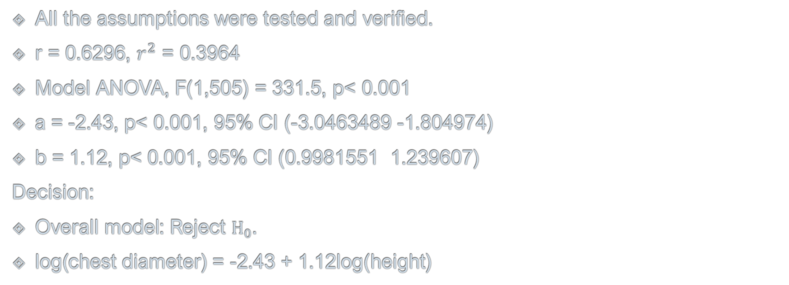
Regression Test Summary
All the assumptions were tested and verified.
r = 0.6296, $r^{2}$ = 0.3964
Model ANOVA, F(1,505) = 331.5, p< 0.001
a = -2.43, p< 0.001, 95% CI (-3.0463489 -1.804974)
b = 1.12, p< 0.001, 95% CI (0.9981551 1.239607)
Decision:
Overall model: Reject $H_{0}$.
log(chest diameter) = -2.43 + 1.12log(height)

Slide 19
Discussion
There was a statistically signiﬁcant positive linear relationship between chest diameter and height.
The relationship between chest diameter and height is as follows.
log(chest diameter) = -2.43 + 1.12log(height)
This equation fits the linear regression model with the error residual 0.25
Log(chest diameter) increases by 1.12 as log(height) increases by 1.
This equation can be used to predict further values of the relationship.

Slide 20
References
MATH1324 Introduction to Statistics Week 2 Demonstration - Introduction to R and RStudio (Course Material)
MATH1324 Introduction to Statistics Week 10 Demonstration Continuous Relationships (Course Material)

